Slide 1
Set Similarity join with spark BIG DATA MANaGEMENT AND GOVERNANCE
Vito D’Elia – Lorenzo Sasso

Slide 2
Introduction - Set similarity join
Set similarity join is a computational task that involves identifying similar pairs of sets INSIDE a collection of sets. In this context, a "set" refers to a collection of distinct elements with no specific order. The similarity between sets is typically measured using a similarity metric, such as Jaccard similarity or cosine similarity.
The goal of set similarity join is to efficiently discover pairs of sets that share a certain level of similarity based on the chosen metric. This task finds applications in various fields, including: data mining, information retrieval.. LIKE IMAGE-FINDING BY EXTRACTING THE FEATURES.. MUSIC-FINDING. Algorithms for set similarity join aim to optimize the computational complexity of comparing sets, making it feasible to identify similar sets from large datasets efficiently.

Slide 3
Objectieves
In this project, the objective is to implement Set Similarity Join using Apache Spark to identify similar pairs INSIDE A various datasets that share the same structure but differENT in size.
–Record{field1,fieldx…} in json collection-
This aims to test the algorithm's performance as the data size increases.
In the initial phase, preprocessing is conducted to prepare the datasets for our task, so the document Have to be tokenized.
Subsequently, the data IS filtered to reduce the number of pairs for comparison, ensuring acceptable execution times.
Finally, the Jaccard Similarity is applied as the similarity function to the candidate pairs. In the concluding stage, precision, recall, and algorithm execution time are calculated.
The results are presented graphically for performance analysis.

Slide 4


TOOLS and Technologies
Databricks Community edition
Pyspark
Within the Python notebooks, the PySpark library was employed to utilize Apache Spark. Thanks to this library, data processing could be parallelized across a cluster OF NODEs, support for in-memory data caching was facilitated and integration with various data sources, such as in our case, the Databricks File System (DBFS), was made possible.
This library allowed us to abstract from the dataset format, transforming records into Resilient Distributed Datasets (RDD).
This project was developed using Databricks Community edition, That enable the possibility to code in Python, with PySpark library to leverage the Apache Spark architecture.
Databricks OFFERS a cluster OF MACHINE WITH AN INSTANCE OF APACHE SPARK 3.3.2 WITH 15GB of RAM, 2 CORES IN 1NODE

Slide 5
Dataset overview
Description
Dataset size
The initial dataset, in which to search for similar pairs, is a file in JSON format. Each record contains various fields describing information about individuals. The dataset was treated as 'raw' text, disregarding the 'json' format. During preprocessing, each record Was LOADED to the RDD to enable partition and parallelization of data and computation.
We had three datasets at our disposal, all in the same format and containing identical types of content but with varying sizes: 10K, 50K, and 100K records.
THE algorithm was TESTED INITIALLY TO THE 10k DATASET THAT allowe us to fine-tune each parameter to achieve optimal results and acceptable execution times ALSO IN THE CASE the data size increased
Ground truth
Finally, we had three ground truth datasets, one for each initial dataset, containing pairs of duplicates within each. In the concluding phase, the resulting similar pairs were compared with those in the ground truth datasets to obtain a metric for the achieved results

Slide 6
Dataset - Example
Extract from the 10k dataset
Extract from the Ground truth dataset
{"d1Id":"101","d2Id":"8933"}
{"d1Id":"4101","d2Id":"4614"}
{"d1Id":"7213","d2Id":"8466"}
{"realProfileID":"0","date_of_birth":"19390609","surname":"bishop","address_1":"daley crescent","street_number":"41","postcode":"6050","soc_sec_id":"4676841","suburb":"batlow","phone_number":"08 29028996","state":"qld","given_name":"molly","age":"31"}
{"realProfileID":"1","date_of_birth":"19041109","address_1":"nambucca street","surname":"aidon","postcode":"2002","soc_sec_id":"3414163","street_number":"7","suburb":"devonort","phone_number":"08 75629459","state":"vkf","given_name":"whkt"}
Example of two similar records
{"realProfileID":"101","surname":"delledonne","address_1":"jerrabomberrfa avenue","date_of_birth":"19741026","postcode":"4817","street_number":"71","soc_sec_id":"6315417","suburb":"blue muoain","phone_number":"04 11928712","state":"qld","given_name":"teiodah","age":"26"}
{"date_of_birth":"19741026","address_1":"jerrabomberra avenue","address_2":"liselican","postcode":"4817","soc_sec_id":"6315417","given_name":"teileah","realProfileID":"8933","surname":"delledonne","street_number":"71","suburb":"blue mountain","phone_number":"04 11928712","state":"qld","age":"26"}
{"realProfileID":"4101","surname":"mason","address_1":"mcgrowdie place","date_of_birth":"19010918","postcode":"3550","soc_sec_id":"9182062","suburb":"kardinya","state":"nsw","given_name":"emalene","age":"38"}
{"realProfileID":"4614","date_of_birth":"19951039","address_1":"mcgrowdie place","surname":"massxo","postcode":"3550","soc_sec_id":"9182062","suburb":"kardinya","given_name":"emalneke","age":"38"}

Slide 7
Methodolgy – outline
Preprocessing
Prefix filtering
Length filtering
Positional filtering
Jaccard similarity application

Slide 8
preprocessing
Load the json file
The code json_rdd = sc.textFile(json_file_path) reads the contents of the file as plain text (located at the json_file_path) and creates an RDD where each element corresponds to a line in the text file. This is often the first step in processing data with Spark, as it allows you to work with large datasets that are distributed across a cluster. SO IT'S ALREADY PARALLELIZE and it reads the data in parallel from multiple workers in the cluster and distributes it across the RDD.
Tokenization
In OUR CASE Due TO THE FACT THAT INSIDE THE RECORDS WE NOTICE A FIELD THAT CONTANINS SOME MISSPELLINGS OR TYPOS IN SINGLE WORDS WE CHOOSE TO TOKENIZE THE RECORDS WITH Q-3 (Q-GRAMS) THAT CReatE a rich representation of text data TO capturE local patterns within strings. is particularly useful for fuzzy matching, as it allows for the detection of similarities even in the presence of minor differences or typographical errors. The tokens in an RDD for each record are tuple of (recordID, [token1, token2, ...]). We ALSO TESTEd THE WORD-TOKENIZATION METHOD THAt WAS THE BEST TO USE FOR COMPUTATIONAL REASON BUT HOW WE WILL SEE IN THE RESULTS WAS VERY unsuitable.
Compute the frequency of the token
The frequency of each token is computed across all sets
Sort tokens by frequency
we have the (token, frequency) in each worker and the (RID, {tokens}) RDD. The sort_tokens_by_frequency function aims to reorder the tokens in each record of an RDD based on their global frequency, which was previously computed and broadcasted. Tokens are sorted based on their frequency in ascending order, meaning the rarest tokens (lowest frequency) appear first, followed by more common tokens.. THIS TO AVOID IN tHE CASE OF PREFIX-FILTER (THAT IS LOOKING AT THE FIRST N-TOKEN) TO WORK ON COMMON TOKENS THAT could “trigger more false positives”
*IT'S DONE LOCALLY ON EACH WORKERS

Slide 9
Preprocessing - Code snippets
def read_json_file(json_file_path):
# Start a Spark Context
sc = SparkContext.getOrCreate()
# Read the JSON file as plain text
json_rdd = sc.textFile(json_file_path)
return json_rdd
# Call the function to read the JSON file
json_rdd = read_json_file(json_file_path)
def sort_tokens_by_frequency(rdd, broadcast_freq):
"""
Sort the tokens in each record by their global frequency.
Parameters:
- rdd: Input RDD where each record is of the form (recordID, [token1, token2, ...])
- broadcast_freq: A Spark broadcast variable containing the global frequency of tokens.
Returns:
- An RDD with each record having tokens sorted by their frequency.
"""
def sort_tokens_by_freq(record):
# unpack the record
record_id, tokens = record
# Use the broadcast variable for sorting from rare to common
sorted_tokens = sorted(tokens, key=lambda token: broadcast_freq.value.get(token, 0)) # if no frequencies are founded = 0
# Return the RID with the Sorted Tokens
return (record_id, sorted_tokens)
# Apply the function MAP on each RDD record
sorted_rdd = rdd.map(sort_tokens_by_freq)
return sorted_rdd
def generate_trigrams(text):
"""
Generates trigrams (3-grams) for a given text, treating each word separately.
Parameters:
- text: A string from which trigrams will be generated.
Returns:
- A set of trigrams for the text.
"""
text = text.lower().replace(" ", "") # Remove white spaces from the text
# Generate trigrams
trigrams = set(text[i:i+3] for i in range(len(text) - 2))
return trigrams

Slide 10
Prefix filtering
The primary goal of the prefix filter is to significantly reduce the number of candidate pairs that the more computationally intensive subsequent filters (like positional filtering) have to deal with, But EXPECIALLY TO REDUCE THE POSSIBILE PAIRS TO COMPARE THAt which being a Cartesian product have quadratic complexity. The chosen threshold should balance computational efficiency with the risk of missing similar pairs.
the idea is to create an index: we index the first n-tokens and if two tokens are indexed together (shuffle phase and group-by-key) the RESPECTIVE RIDS are candidates to reach the threshold.
Generate Key-Value Pairs for Prefix Tokens:
For each record, we emit key-value pairs for every token in its prefix, where the key is the token and the value is the record's RID.
Generate pairs of the form (token, record_id)
Calculating Prefix Length:
The function dynamically calculates the prefix length for each record using the formula:
Prefix Length = Tokens_of_record|doc − ⌈threshold × Tokens_of_record⌉ + 1
In our case We MAKE SOME MODIFICATION FROM THE APPROACH OF [Chaudhuriet al, ICDE’06]
This allow to adjusting the prefix length DYNAMICCALLY based on the size of EACH token sets and the desired similarity threshold, this ensures that the number of tokens considered for each record is proportional to its size that allows to fine-tune the filtering process.
before the reducer starts, there's a shuffle phase. All emitted key-value pairs are shuffled across the network so that all pairs with the same key (in this case with the same token) are grouped together and end up on the same machine.
This requires moving data across different nodes in the cluster, which can be network-intensive, especially for large datasets.
THEN the reducer groups k-v pairs by their keys. all the RIDs that have the same token in their prefix are collected together.
After the shuffle, for each unique token, WE get an iterable of record IDs (rids) that contain this token. This operation effectively groups all rIDs by common tokens… Essentially, it's an inverted index {token, rids}

Slide 11
extract candidate pairs after Prefix filtering
For each token, take the list of RIDs and form candidate pairs. This essentially means for a list of RIDs [a, b, c], WE will form pairs [(a, b), (a, c), (b, c)].
The idea behind this step is that if two records share a token in their prefix, they might be similar. Hence, they are considered as candidate pairs and will be subjected to subsequent filters to restrict down true similarities.
The function generate_candidate_pairs:
Generate all 2-combinations of the list of RIDs. For each token returns all possible pairs of RIDs that have this token in their prefix.
input (kv) is a key-value pair, where the key is a token and the value (kv[1]) is a list of RIDs associated with that token.
flatMap "flattens" the results, producing an RDD of the individual elements instead an RDD of list

Slide 12
Prefix filter - Code snippets
def generate_prefix_pairs_from_rdd(rdd, threshold_prefix):
"""
Generates prefix pairs for each record in the RDD dynamically based on threshold.
Parameters:
- rdd: Input RDD where each record is of the form (recordID, [token1, token2, ...])
- jaccard_threshold: The Jaccard similarity threshold.
Returns:
- An RDD with prefix pairs.
"""
def generate_prefix_pairs(record):
record_id, tokens = record
# contains the number of tokens of each record
n = len(tokens)
# Dynamic calculation of prefix length
prefix_length = n - int(threshold_prefix * n) + 1 #prefix_lengh = docLen|A| - t + 1
if prefix_length <= 0:
return []
for i in range(prefix_length):
yield (tokens[i], record_id)
prefix_rdd = rdd.flatMap(generate_prefix_pairs)
return prefix_rdd
#SHUFFLING AND REDUCING
grouped_rdd = prefix_rdd.groupByKey()
def generate_candidate_pairs(grouped_rdd):
"""
Generates candidate pairs of RIDs that share a common token in their prefix.
Parameters:
- grouped_rdd: Input RDD where each record is a key-value pair. The key is a token and the value is a list of RIDs associated with that token.
Returns:
- An RDD of candidate pairs, where each element is a tuple representing a pair of RIDs that share at least one common token in their prefix.
"""
candidate_pairs_after_prefix_rdd = grouped_rdd.flatMap(lambda kv: combinations(kv[1], 2))
return candidate_pairs_after_prefix_rdd
candidate_pairs_after_prefix_rdd = generate_candidate_pairs(grouped_rdd)

Slide 13
Length filter
Firstly we Create an RDD of records with RID and length of the token set:
The lambda function "lambda kv": (kv[0], len(kv[1])) takes each key-value pair kv (where kv[0] is the RID and kv[1] is the token set) and transforms it into a new pair (RID, number_of_tokens)
The result is a new RDD, record_lengths_rdd, where each element is a tuple consisting of a record ID and the corresponding number of tokens in that record.
The next step is to join the candidate pairs with their corresponding token lengths. The join operation combines records with the same key (RID) from both RDDs. The result, pair_lengths_rdd, will have elements in the form: {RID1, (RID2, length_of_RID1)}.
After, we restructure the RDD to facilitate another join to get lengths for both RIDs in the pair, by swapping the keys and values. The key becomes RID2, and the value becomes a tuple (RID1, length_of_RID1).
After this mapping, we join the refactored RDD with record_lengths_rdd again. The resulting RDD, pair_lengths_rdd_refactored, will have elements in the form: {RID2, ((RID1, length_of_RID1), length_of_RID2)}.
By knowing the lengths of the token sets for each pair of RIDs, we can apply lenght filter, considering only the pairs where the length difference is within a certain threshold.

Slide 14
Length filter - core
This is the core step of the length filter: if the lengths of the two sets in a pair are too different, they can't possibly have a high similarity.
For example: Pair: ('7078', (('4481', 63), 57)) Lengths: RID1 (4481) = 63, RID2 (7078) = 57
-Min Length = min(63, 57) = 57
-Max Length = max(63, 57) = 63
-Max Possible Overlap = Min Length = 57
-Min Required Overlap = Threshold × Min Length = 0.7 × 57 ≈ 40
So the check of filter:
(Min Length - Max Length + Max Possible Overlap) = (57 - 63 + 57) = 51 Since 51 is greater than the Min Required Overlap (40), this pair passes the filter, can match So the rdd is returned.
After the length filter, we will have an RDD like: {RID2, ((RID1, length_of_RID1), length_of_RID2)}.
Now, we just need the RID pairs (RID1, RID2), so we can map the structure to get only the pairs of RIDs.
WE USED A CUSTOMIZE FILTER INSTEAD OF THE CLASSICAL [Bayardo et al, WWW 07 ] BECAUSE IN OUR CASE WAS NOT EFFECTIVE

Slide 15
Length filter - Code snippets
# compute the lenght of the token set for each record - len(kv[1]) -> number of tokens in the set
record_lengths_rdd = tokenized_rdd.map(lambda kv: (kv[0], len(kv[1])))
# join on RID # MAPPER
# REDUCER (join): brings together pairs from RDDs that have the same key. Combines records with the same key (RID) from both RDDs.
pair_lengths_rdd = candidate_pairs_after_prefix_rdd.join(record_lengths_rdd) #
print("pair_lengths_rdd: {RID1, (RID2, lenght_of_RID1)} ", pair_lengths_rdd.take(1))
pair_lenghts_rdd_refactored = pair_lengths_rdd.map(lambda kv: (kv[1][0],(kv[0], kv[1][1]))).join(record_lengths_rdd)
def filter_pairs_by_length(pair_lengths_rdd_refactored, threshold_lenght):
"""
Filters the RDD pairs based on the given length criteria derived from the similarity threshold.
Parameters:
- pair_lengths_rdd_refactored: RDD in the format {RID2, (RID1, length_of_RID1, length_of_RID2)}.
- threshold: Desired similarity threshold.
Returns:
- An RDD with pairs filtered by the given criteria.
"""
def length_filter(value):
# take the tuple that contains the lenghts of the 2RIDs
rid1_length = value[0][1]
rid2_length = value[1]
min_length = min(rid1_length, rid2_length)
max_length = max(rid1_length, rid2_length)
# Calculate the maximum possible overlap
max_overlap = min_length
# Derive the minimum required overlap - the min. number of tokens that must overlap for the pair to be considered similar.
min_required_overlap = threshold_lenght * min_length
# Check the minimum required overlap against the maximum possible overlap
return (min_length - max_length + max_overlap) >= min_required_overlap
#MAPPER
pairs_after_lenght_rdd = filtered_pairs_after_lenght_rdd.map(lambda kv: (kv[1][0][0], kv[0]))

Slide 16
positional filter (1)
Positional filtering checks if the common tokens between two records appear at nearly the same positions. If they do, it's likely that the records are similar. This step is particularly useful to eliminate false positives introduced by common tokens that appear at widely different positions in two records.
Token positioning:
For each record, mark each token with its position. This function takes a set of tokens and returns a list of tuples, each consisting of a token and its corresponding index (position) in the set. IT’s ASSOCIATION OF TOKEN WITH ITS POSITION.
[ ('record_id1', [('token1', 0), ('token2', 1), ...]), ('record_id2', [('tokenA', 0), ('tokenB', 1), ...]), ... ]
Join the distinct_pairs_rdd with the positioned_rdd based on tokens:
Now, by using this positioned RDD (positioned_rdd) we:
-Join candidate pairs (RID1, RID2), based on their tokens, and filter OUT based on their positions.
To achieve this, we first need to do the join operation on final_pairs_rdd with the positioned_rdd and then perform the positional filtering.
We have the positioned_rdd in the format: ('record_id', [('token1', position1), ('token2', position2), ...])
And the pairs_after_lenght_rdd (from previous prefix filtering) in the format: ('RID1', 'RID2')
The join operation in Spark combines two RDDs based on their keys
Each element in the pairs_after_lenght_rdd is joined with the corresponding element in positioned_rdd based oN RID. This join will result in a new RDD -> the RDD first_join THAT haVE elements in the format:
'RID1', ('RID2', [positioned tokens of RID1]))
This format represents the association of each RID pair with the positioned tokens of one of the records in the pair.

Slide 17
positional filter (2)
Reformat the RID and token, then join again:
The lambda function inside map restructures each element of first_join. It changes the format from ('RID1', ('RID2’, [('token1’, position1), ...])) to the final form: ('RID2', ('RID1’,[positioned tokens of RID1])).
In this step, we're performing a second join operation to bring together the positioned token for both records.
Then join THIS RDD with positioned_rdd on RID2. This operation combines the positioned tokens of RID1 (already in the RDD) with the positioned tokens of RID2 (from positioned_rdd).
After the join, WE HAVE RDD IN THE FORM: ('RID2', (('RID1', [positioned tokens of RID1]), [positioned tokens of RID2]))
Filter out the pairs of records that doesn't satisfy the positional constraint:
similarity_threshold is the minimum number of common tokens that two records must have to be considered similar.
max_positional_difference is the maximum distance allowed between the positions of the same token in the two records.
rec1_tokens contains the positioned tokens from the first record (RID1), and rec2_tokens_dict is a dictionary that is used to lookups the positions of tokens from the RID2.
common_tokens counter is initialized TO 0 and keep track of how many token matches have been found between the 2 records.
possible_common_tokens starts as the minimum length of the 2 token lists (IT's the maximum possible matches) and decrements as we iterate through the tokens of RID1, because there's one less token to potentially match with.
For each token in rec1_tokens, the function looks up the position of the same token in rec2_positions. If the token exists in both records and the absolute difference in their positions is less than or equal to max_positional_difference, it is counted as a common token (common_tokens + 1)
After each token comparison, the function checks if it's still possible to meet the similarity_threshold. It does this by adding common_tokens and possible_common_tokens. If their sum is less than similarity_threshold, the function concludes that the records can't be similar and returns False. This check allows the function to stop early if it's already impossible for the pair to meet the similarity criteria, saving unnecessary computation.
If the loop completes without STOPPING, the function checks if the number of common_tokens found meets or exceeds the similarity_threshold. If YES, the function returns True, indicating that the records are similar, Otherwise, it returns False.

Slide 18
Extract candidate pairs after positional filter
Extract Candidate Pairs:
The goal now is to convert the nested structure of filtered_positional_rdd into a simpler structure: (recordID_A, recordID_B), where recordID_A and recordID_B are the RIDs of PAIRS THAT passed the positional filtering.
to achieve this we Map to Candidate Pair RDD: Extract just the RIDs AND also sort IT
DUPLICATE REMOVALS:
This function ensures that the pairs of RIDs are ordered consistently.
It takes a tuple (RID1, RID2) and checks which RID is smaller. It then returns the pair in sorted order (smaller RID, larger RID).
This way, (A, B) and (B, A) are considered the same because they both become (A, B).
it's possible, especially in distributed systems like Spark, that we might have multiple identical candidate pairs being evaluated more than once. AT THIS POINT IT’S ENOUGHT TO CALL THE .DISTINCT() METHOD ON RDD TO REMOVE DUPLICATE.
Efficiency: By removing duplicates, we reduce the dataset size, which can lead to performance improvements in subsequent processing steps.
After running this, candidate_pairs_ordered_rdd have the structure (recordID_A, recordID_B), where each pair is a candidate for having a Jaccard similarity above the threshold.
Once you have this RDD, you can easily compute the Jaccard similarity for each pair, as you will only have to deal with their RIDs and can use these to retrieve and compare their token sets.

Slide 19
positional filter - Code snippets
def position_tokens(tokens):
return [(token, idx) for idx, token in enumerate(tokens)]
# mapValues only processes the values of the key-value pairs in the RDD, leaving the keys (the record IDs) unchanged.
positioned_rdd = tokenized_rdd.mapValues(position_tokens)
positioned_rdd = positioned_rdd.cache()
#positioned_rdd have the same keys (RID) of tokenized_rdd, but the values now are lists of (token, index) pairs instead of sets of tokens.
first_join = pairs_after_lenght_rdd.join(positioned_rdd)
second_join = first_join.map(lambda kv: (kv[1][0], (kv[0], kv[1][1]))).join(positioned_rdd)
def positional_filter_optimized(pair, similarity_threshold, max_positional_difference):
RID2, ((RID1, rec1_tokens), rec2_tokens_dict) = pair
# Initialize counters
common_tokens = 0
# Create a dictionary for the second record for fast lookups
rec2_positions = {token: pos for token, pos in rec2_tokens_dict}
# Calculate the maximum possible common tokens at the beginning
possible_common_tokens = min(len(rec1_tokens), len(rec2_tokens_dict))
# Iterate through the positioned tokens of the first record (the prefix)
for token, pos1 in rec1_tokens:
# Decrement possible common tokens as we advance
possible_common_tokens -= 1
pos2 = rec2_positions.get(token)
if pos2 is not None and abs(pos1 - pos2) <= max_positional_difference:
common_tokens += 1
# Apply early stopping rule based on the similarity threshold
if common_tokens + possible_common_tokens < similarity_threshold:
return False
# If we complete the loop without returning False, the pair is similar
return common_tokens >= similarity_threshold
# Apply the filter to the second join RDD
filtered_positional_rdd = second_join.filter(lambda pair: positional_filter_optimized(pair, similarity_threshold, max_positional_difference))
# Extracting candidate pairs and sorting
candidate_pairs_rdd = filtered_positional_rdd.map(lambda x: (x[1][0][0], x[0]))
candidate_pairs_final_rdd = candidate_pairs_rdd.map(lambda x: tuple(sorted(x)))
def order_rids(pair):
RID1, RID2 = pair
return (RID1, RID2) if RID1 < RID2 else (RID2, RID1)
candidate_pairs_ordered_rdd = candidate_pairs_final_rdd.map(order_rids)
# take only the "unique" candidate pair
distinct_candidate_pairs_rdd = candidate_pairs_ordered_rdd.distinct()

Slide 20
Jaccard similarity application
For each of the candidate pairs, you can compute the Jaccard similarity using their token sets. This will allow to filter out those pairs whose Jaccard similarity is below desired threshold.
SO we Join OUR CANDIDATE PAIRS OF RIDS (A,b) WITH THE the Tokenized RDD TO retrieve the original token sets for both RID1 and RID2.
distinct_candidate_pairs_rdd is mapped to include the record ID (x[0]) as a key and the pair itself (x) as a value. You join this RDD with tokenized_rdd to bring in the tokens for the first record
THEN WE map the result to restructure it, using the second record ID in the pair as the key for another join with tokenized_rdd to bring in the tokens for the second record.
After the second join, WE map the result to create a final DATA structure where each element is a tuple of:
A pair of record ID: (record1, record2) WITH Corresponding tokens LIST: (tokens1, tokens2)
The output is an RDD where each entry has the structure ((record1, record2), (tokens1, tokens2)), which we can use to compute the Jaccard Similarity.
We will now compute the Jaccard similarity for each pair using the formula: Jaccard(A,B)= ∣A∪B∣/∣A∩B∣ ​
FROM WHICH WE GET OUT A JACCARD_RDD WITH THIS STRUCT: [(('23014', '52978'), 0.13095238095238096)] – RID1,RID2, SIMILARITY-
THIs RDD WILL BE USED THEN IN THE METRICS CALCULATION A LOT OF TIMES SO IT’S CACHED.

Slide 21
Jaccard similarity application - Code snippets
# This results in an RDD where each entry is ((record1, record2), (tokens1, tokens2))
paired_tokens_rdd = distinct_candidate_pairs_rdd.map(lambda x: (x[0], x)).join(tokenized_rdd).map(lambda x: (x[1][0][1], x[1])).join(tokenized_rdd).map(lambda x: ((x[1][0][0][0], x[0]), (x[1][0][1], x[1][1])))
paired_tokens_rdd = paired_tokens_rdd.cache()
def jaccard_similarity(set_a, set_b):
"""Calculate the Jaccard Similarity between two sets
Args:
set_a (set): The first set.
set_b (set): The second set.
Returns:
float: The Jaccard Similarity between the two sets.
"""
intersection = len(set_a.intersection(set_b))
union = len(set_a.union(set_b))
# Avoid division by zero
if union == 0:
return 0.0
return intersection / union
# Computing Jaccard Similarity for each pair
jaccard_rdd = paired_tokens_rdd.map(lambda x: (x[0], jaccard_similarity(x[1][0], x[1][1])))
jaccard_rdd = jaccard_rdd.cache()

Slide 22
Results
Load the ground truth dataset
In order to show the results, the ground truth dataset is Loaded, then it’s converted into an RDD, and then mapped it to a tuple format that pairs each d1Id with its corresponding d2Id.
Plot the results
WE DEFINED THE FUNCTION TO CALCULATE THE METRICS BY WATCHING INSIDE THE RDD OF GROUND TRUTH
Filter by Thresholds: for a range of thresholds, we filter jaccard_rdd to retain only those pairs with a similarity above the threshold AND PUT THE RESULTS IN filtered_pairs_set
Evaluate Against Ground TrutH, we compare filtered pairs against this ground truth to determine precision and recall.
Measure Execution Time: for each threshold, we measure the time it takes to perform the filtering and evaluation and then we add this time to the base_time_of_pipeline that measure the time passed from the starting of WHOLE ALGORITHM
Plot the Results: finally we plot precision, recall, and execution time against the different threshold values.

Slide 23
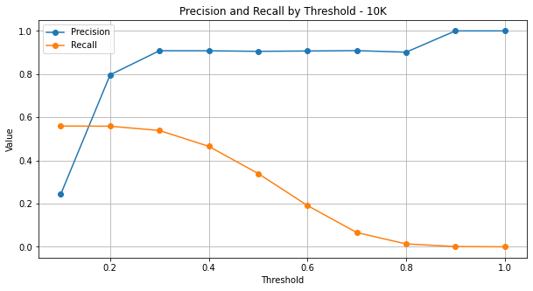
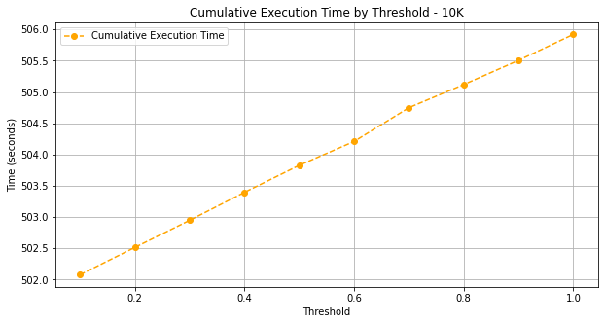
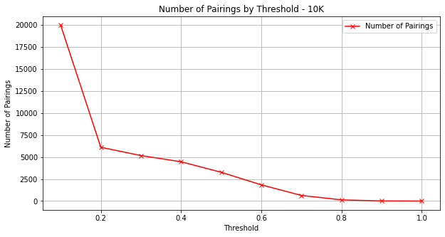
Results – 10k dataset

Slide 24
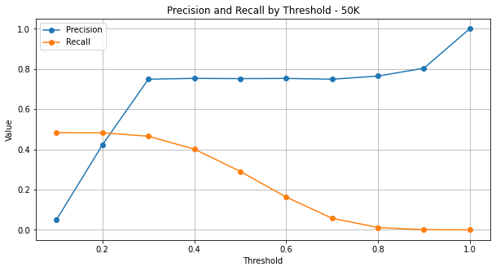
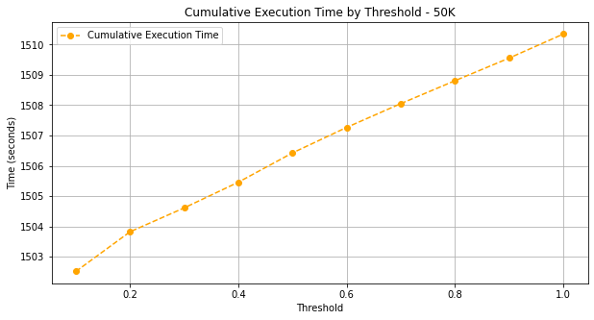
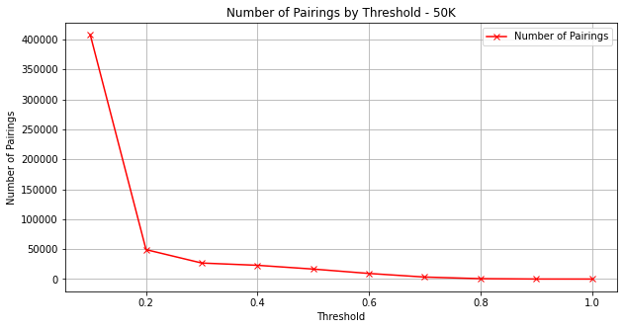
Results – 50k dataset

Slide 25
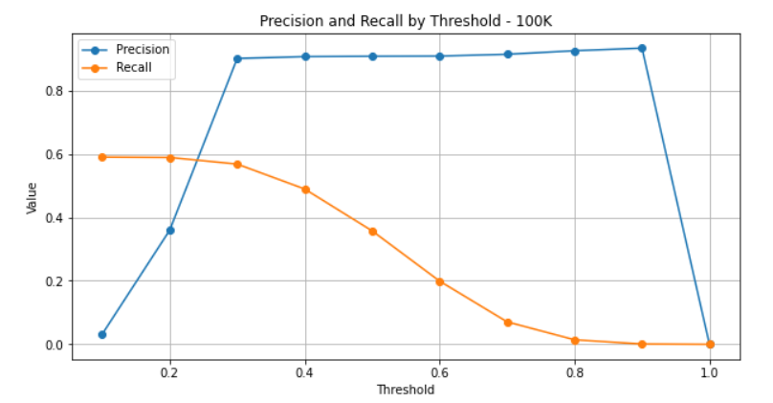
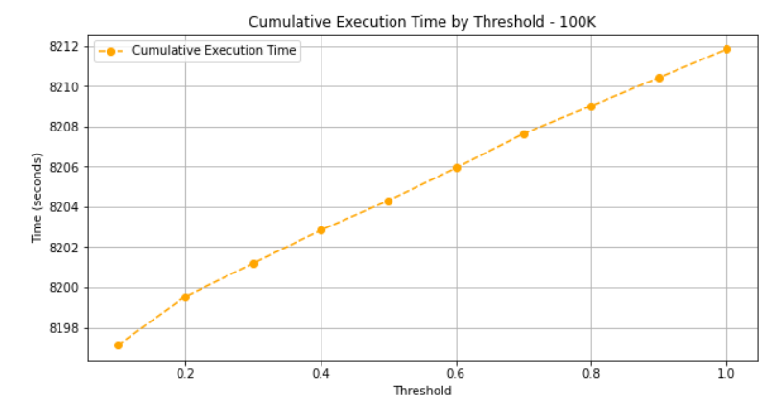
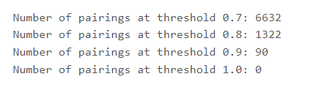
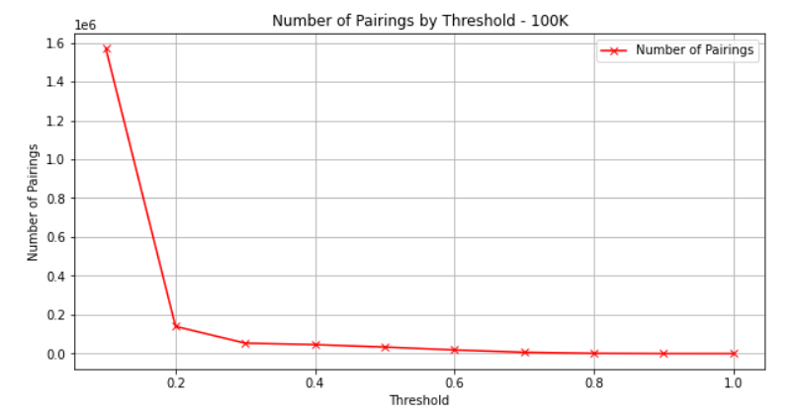
Results – 100k dataset WITH Q-3

Slide 26
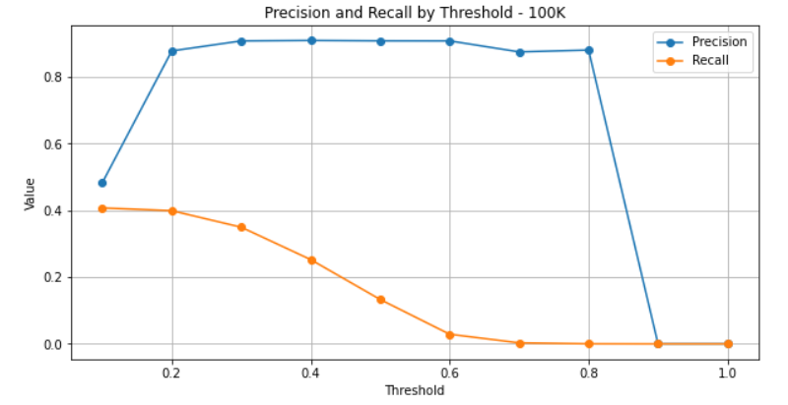
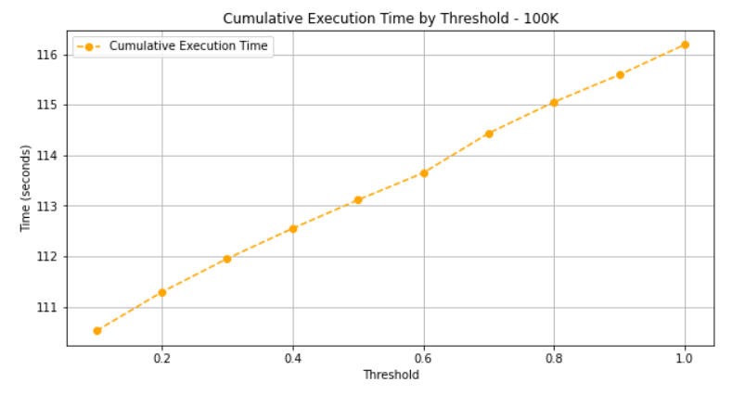
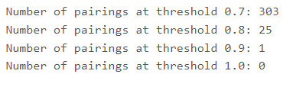
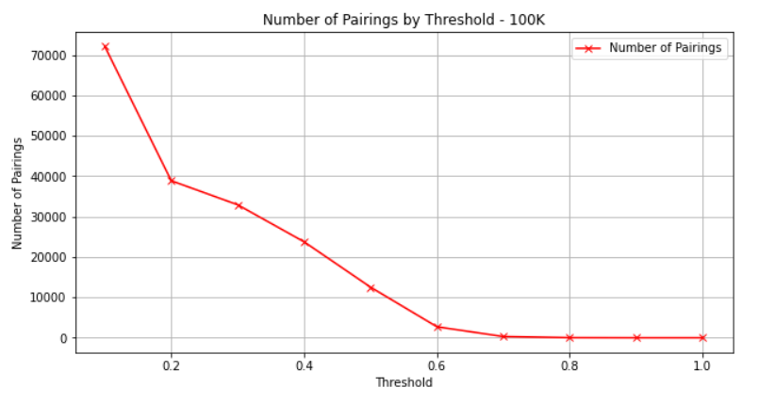
Results – 100k dataset WORD TOKENIZATION

Slide 27
Possible developments and challenges
What can be improved?
From a 'production' environment poV, it’S possible to potentially reduce execution times by a lot by eliminating debug checks that we used to keep track of what was happening after the various rdd transformations. This is possible by eliminating all unnecessary actions that cause data to travel to the driver -such as .take() and .collect()-
It would then be possible to analyse the load of each individual task on the available cores through the SparkUI and then possibly use custom functions to make a fairer partitioner in the distribution of keys
Our issues?
The biggest of all was dealing with the limits imposed by the databricks community environment, which limits the execution of tasks to 1h after which the environment is reset and “work is lost”.
Familiarise with the field of distributed computing, which often presents unexpected results that can, however, with appropriate debugging tests, be addressed

Slide 28
Thanks for your attention

